Slide 1


Slide 2
…but before we talk about REDCap
You now have OUHSC Credentials (Sorry pokes fans)
Here are a few links of interest to you and your new OUHSC account
Accessing your OUHSC e-mail
https://webmail.ouhsc.edu
Changing your password
http://www.ouhsc.edu/password.aspx

Slide 3
What is REDCap?
Online secure database created by Vanderbilt University
OUHSC has been using REDCap since 2012
Only software requirements are internet access and a web browser.
Training and other info located at:
https://bbmc.ouhsc.edu/redcap/bbmc/REDCap.html

Slide 4
Where is it?
https://bbmc.ouhsc.edu/

Slide 5
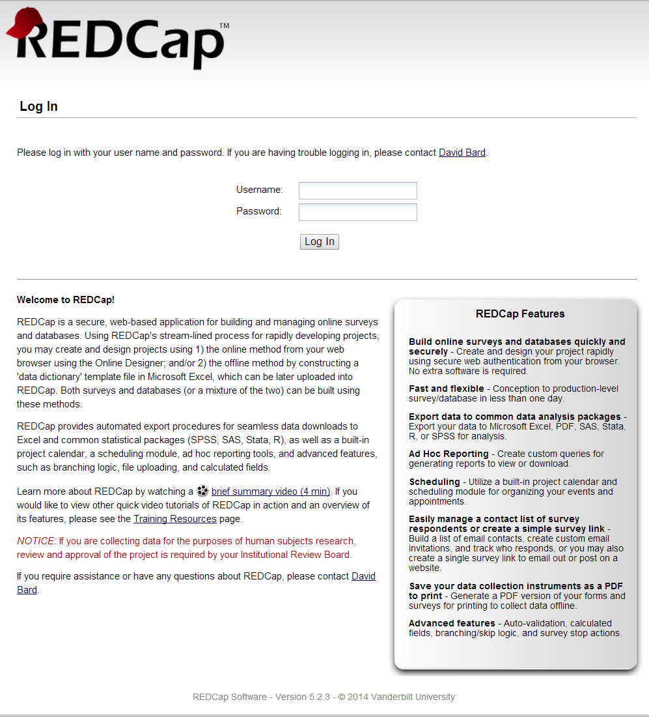
REDCap Login Page

Slide 6
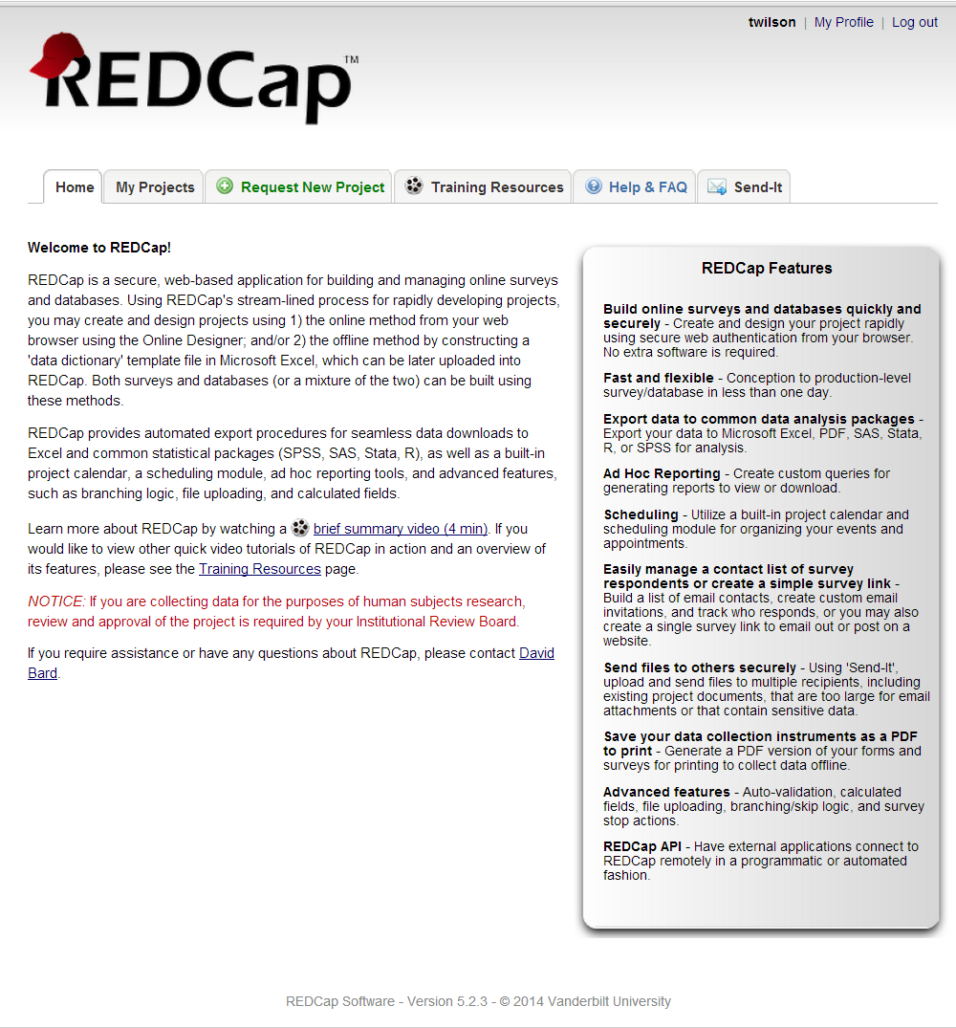
REDCap Main Menu

Slide 7
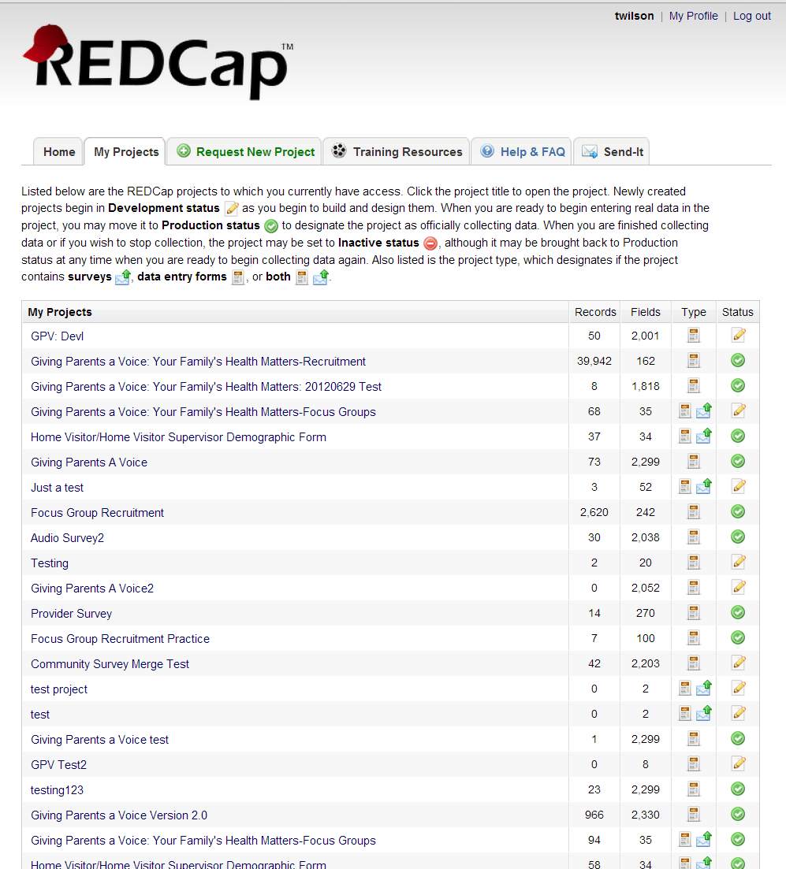
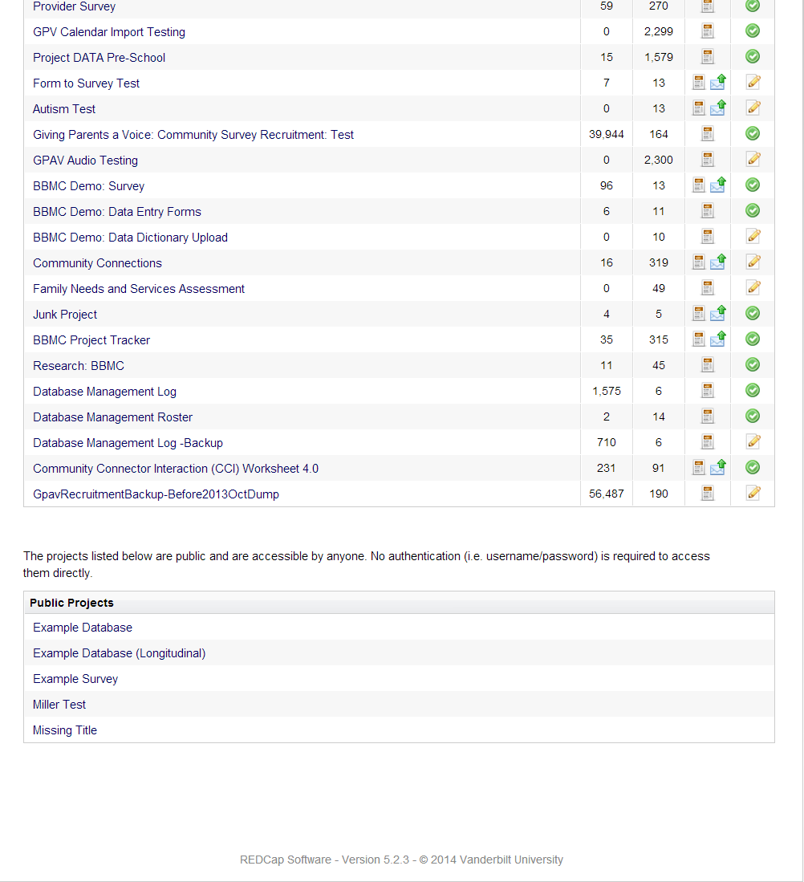
My Projects Tab

Slide 8
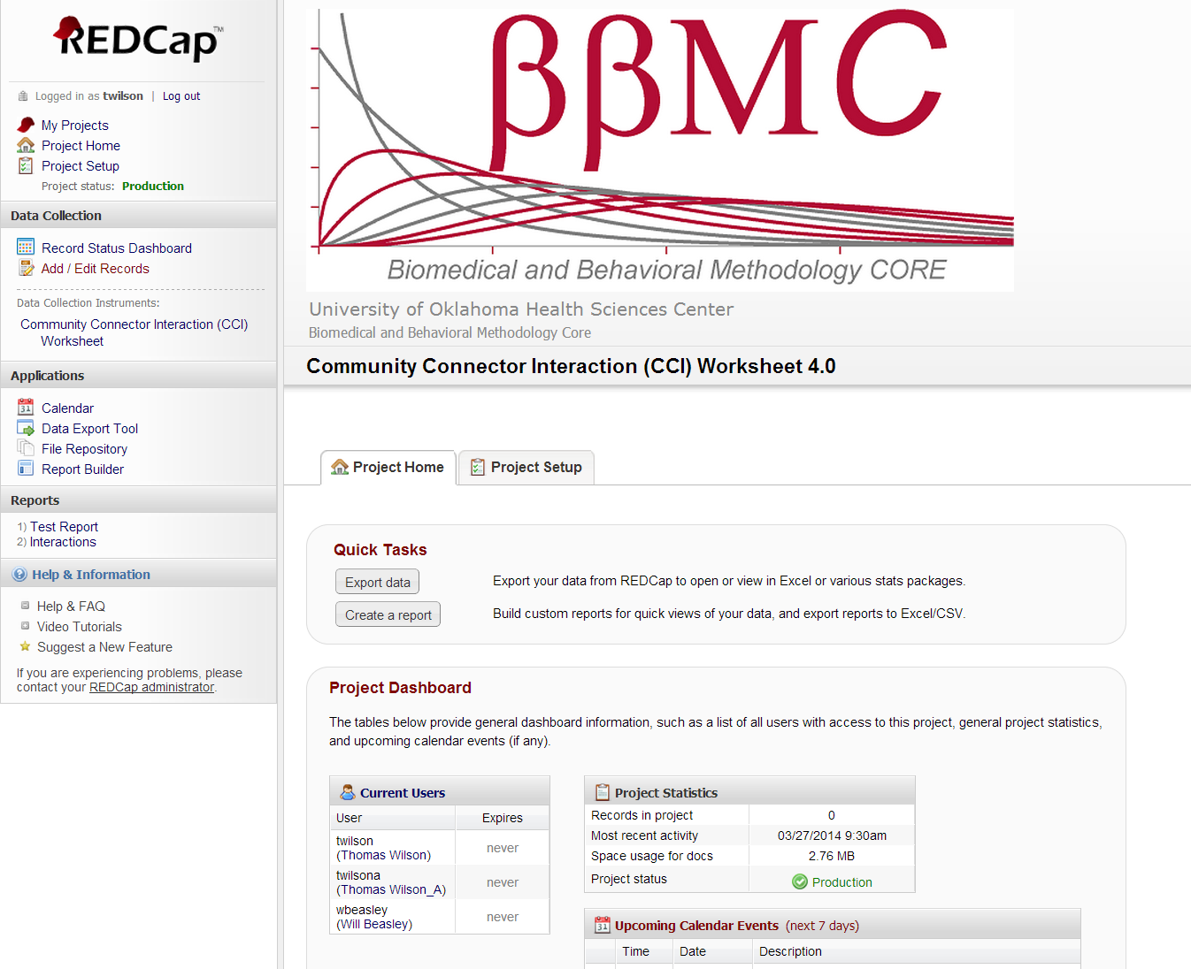
Inside the CCI Worksheet

Slide 9
Creating a New Interaction

Slide 10
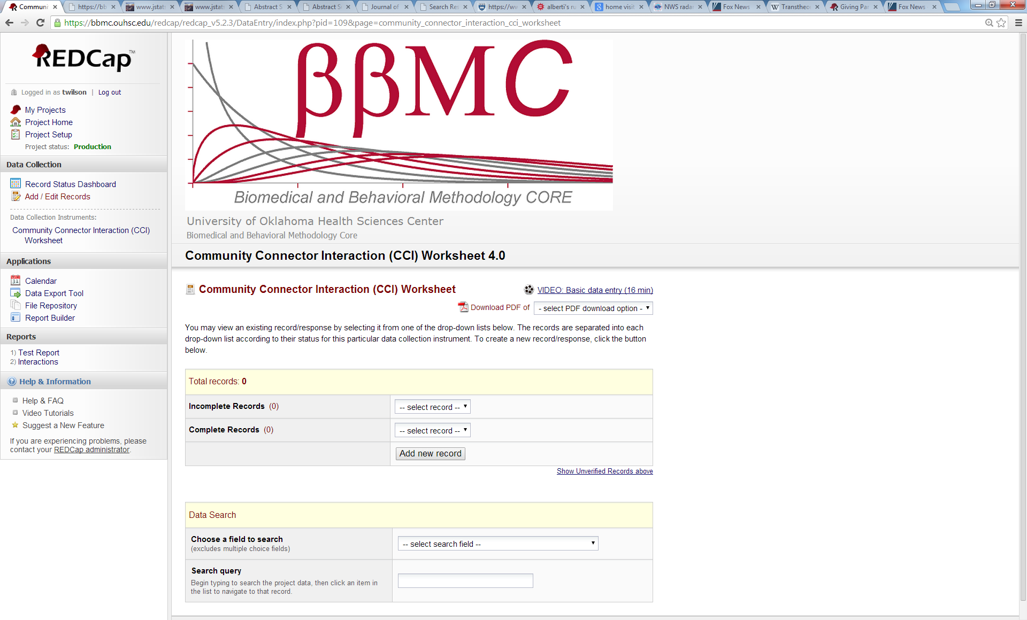
Creating a New Interaction

Slide 11
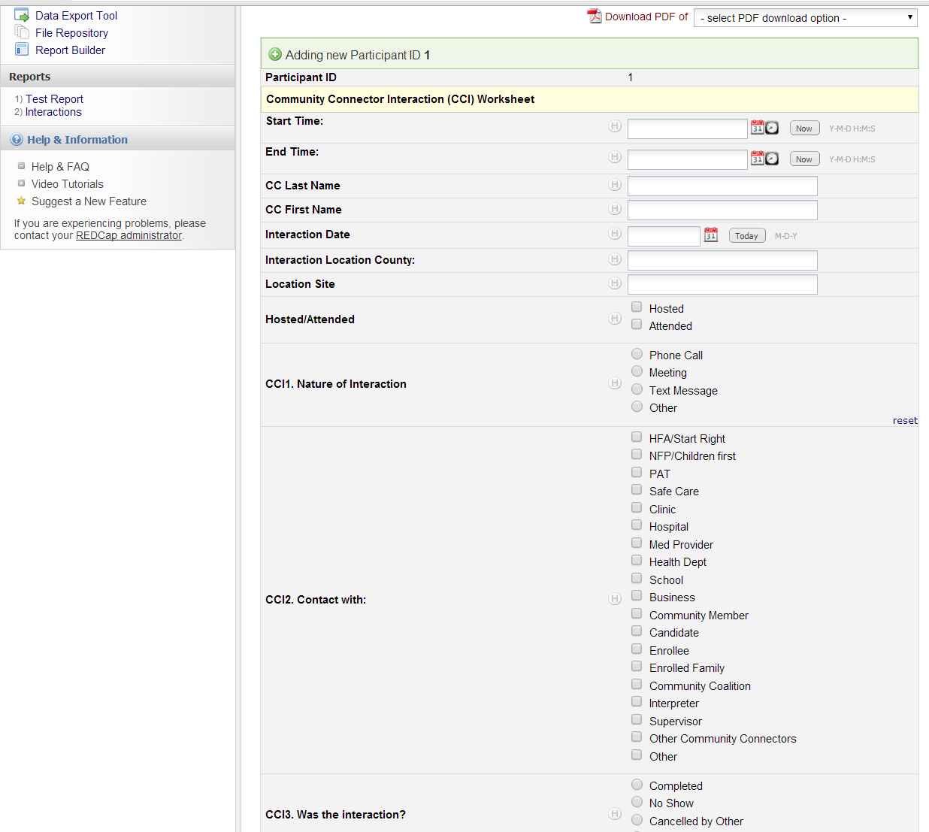
New Record
Created Automatically

Slide 12
Types of Responses
Text box
Free Response Text: name, county, site, etc
Free Response Number: number of contacts, etc
Date
Radio Button
Only one option may be selected
Check Box
Multiple options may be selected

Slide 13
Text Box Free Response Text

Slide 14
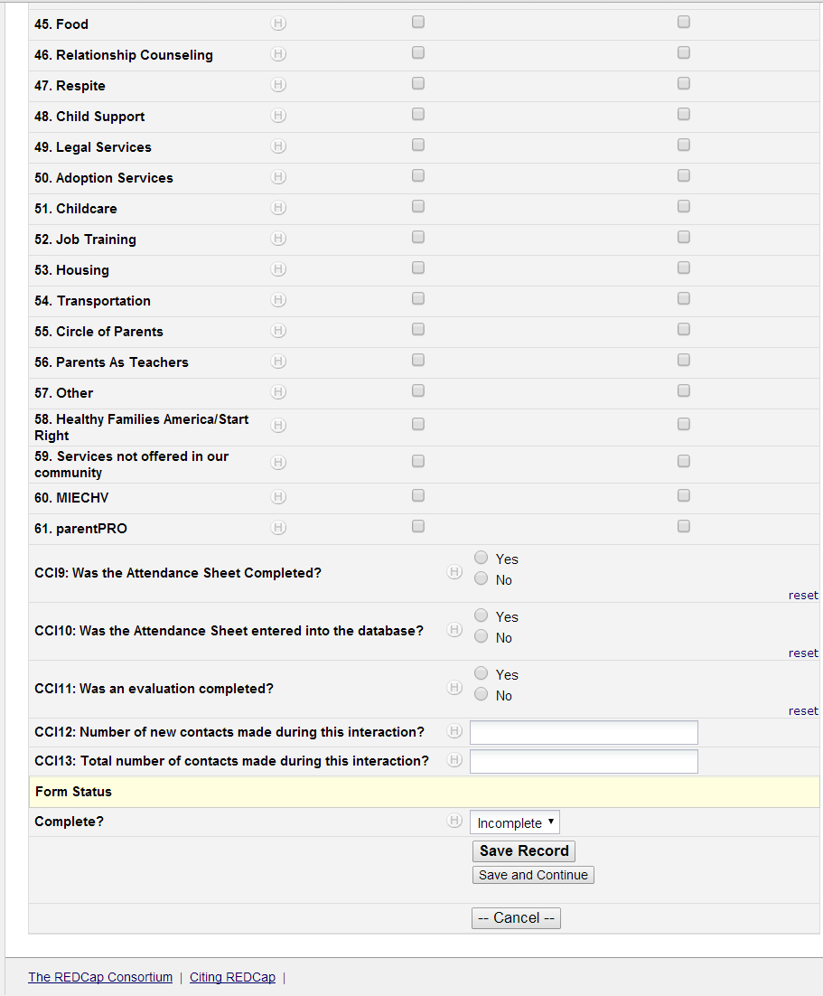
Text Box Free Response Number

Slide 15
Text Box Date

Slide 16
Radio Button

Slide 17
Check Box

Slide 18
Completed Form
Three Options when saving a record
Incomplete
Unverified
Complete
Save Record
Saves the record and exits the data entry screen
Save and Continue
Saves the record and stays in the data entry screen

Slide 19
Completed Form

Slide 20
If you have multiple records, you can repeat this process after saving your work.

Slide 21
Questions?
Thomas Wilson
Cell: (405) 760-7737
Office: (405) 271-8858 ext 42614
e-mail: thomas-wilson@ouhsc.edu

